Slide 1



Detection of Eye and Hair Colour
KLE Society’s
KLE Institute of Technology, Hubballi – 30
Department of Computer Science and Engineering
Under the guidance of : Mrs. Suman Y.
By:
Shreesh Kallihal | 2KE19CS099
Diwakar Nadager | 2KE19CS029
Department of CSE, KLEIT

Slide 2

Abstract
KLE Society’s
KLE Institute of Technology, Hubballi – 30
Department of Computer Science and Engineering
Accurate identification of eye and hair color holds significance in various domains, including forensic investigation, biometric systems, and digital image processing. The proposed method utilizes advanced computer vision techniques and machine learning algorithms to accurately and automatically identify then classify eye and hair color from images or video streams. By employing state-of-the-art convolutional neural networks and color space analysis, our system A robust machine learning model is then trained on a comprehensive dataset, enabling accurate classification of different eye and hair color categories. Experimental results on dataset demonstrate the effectiveness of the proposed approach, achieving high accuracy rates in eye and hair color detection. Furthermore, we introduce a real-time implementation that allows for rapid and reliable color detection, making it suitable for applications such as biometric identification, surveillance, and personalized virtual avatars. Experimental results demonstrate the effectiveness of our approach in achieving highly accurate eye and hair color recognition, outperforming existing methods and paving the way for numerous practical applications in diverse domains.
Department of CSE, KLEIT

Slide 3
Introduction
KLE Society’s
KLE Institute of Technology, Hubballi – 30
Department of Computer Science and Engineering
The detection of eye and hair color using Artificial Intelligence Markup Language (AIML) is an innovative approach that combines AI algorithms and data processing techniques to accurately identify and classify these distinct human features. AIML enables the analysis of genetic markers and visual attributes to determine eye and hair color.
The use of AIML in eye and hair color detection has revolutionized the accuracy and efficiency of the process. By employing AI algorithms, AIML can handle large datasets and extract relevant information to identify specific genetic markers associated with pigmentation traits. Additionally, AIML algorithms can analyze visual data, such as iris patterns and hair color variations, using advanced computer vision techniques. This combination of genetic analysis and visual examination through AIML enables rapid and reliable detection of eye and hair color.

Slide 4
Detection methodologies used in the Project
KLE Society’s
KLE Institute of Technology, Hubballi – 30
Department of Computer Science and Engineering
Multi-task Cascaded Convolutional Networks(MTCNN):
MTCNN is a deep learning-based face detection algorithm that utilizes machine learning
It trains the AIML models with large and diverse datasets
MTCNN used for detecting multiple layers as it returns an array of face coordinates
MTCN refines the AIML models, enhancing their ability
Convolutional Neural Network(CNN):
CNN is a type of deep learning neural network commonly used for image and video processing tasks.
CNN is employed to analyze and process image data
CNN can capture intricate patterns and characteristics specific to eye and hair color.
CNN can accurately classify and identify based on learned features
K-Nearest Neighbors (KNN):
It searches the nearest neighbour
It simply fits training examples with labels and used for prediction

Slide 5

Objectives
KLE Society’s
KLE Institute of Technology, Hubballi – 30
Department of Computer Science and Engineering
to design an accurate system that can detect eye and hair colors with a high level of precision. The AIML model should be trained and optimized to provide reliable results.
To improve the accuracy of detection of eye and hair colour of users in the system. By leveraging large amounts of training data
to design a model that accurately describes the correlation between eye color and hair color.
to develop AIML models capable of efficiently and accurately detecting eye and hair colors in real-time to support real time applications, specifically to meet the requirements of surveillance systems and live video analysis applications..
Department of CSE, KLEIT

Slide 6
Literature survey
Sl.no | Authors | Year | Title | Methodology | Remarks
1 | Harish Bhaskar, S. Bapi Raju | 2014 | Eye color detection using genetic programming | employ a dataset of eye images and use genetic programming to evolve rules for eye color classification. The results demonstrate the effectiveness of the proposed method in accurately detecting eye color. . | proposes a genetic programming-based approach for eye color detection.
2 | Shervin Ardeshir, Nasser Kehtarnavaz | 2017 | "A survey of hair color classification and its applications" | discusses various methodologies, including color-based, texture-based, and hybrid approaches, used for hair color classification.. | a comprehensive overview of hair color classification techniques and their applications
3 | Sang-Eon Lee, Younghoon Kim | 2015 | "Robust eye color recognition using multi-resolution local binary patterns" | extract LBP features from eye images at multiple scales and employ a k-nearest neighbors (KNN) classifier for eye color recognition | robust method for eye color recognition using multi-resolution local binary patterns (LBP).

Slide 7
Literature Survey
Sl.no | Authors | Year | Title | Methodology | Remarks
4 | Roshan Thapa, Sunil Kumar Jangir, Nirmal Kumar Mandal, et al. | 2016 | "Automatic hair color classification using digital image processing techniques" | method that involves hair region extraction, feature extraction, and classification using a support vector machine | automatic hair color classification using digital image processing techniques
5 | Reza Azmi, Reza Abrishami-Moghaddam, Heidar Ali Talebi, et al. | 2020 | "A review on iris and eye color recognition methods" | discusses various techniques, including traditional image processing methods, machine learning algorithms, and deep learning approaches, employed for iris and eye color recognition | a comprehensive overview of iris and eye color recognition methods

Slide 8
KLE Society’s
KLE Institute of Technology, Hubballi – 30
Department of Computer Science and Engineering
Specific Aim Of The Project
As the main aim of this project is to detect eye colour and hair colour. MTCNN is used to locate eye and hair coordinates of the face ,which is further processed for detection of eye and hair colour.
KNN model is trained for eye colour detection and cnn model is trained for hair colour detection, so that gives accurate results.
Department of CSE, KLEIT

Slide 9
KLE Society’s
KLE Institute of Technology, Hubballi – 30
Department of Computer Science and Engineering
In both realtime and dataset,Detecting eye and hair colour in one frame and display results within the frame.
To provide a reliable and efficient solution for automatically detecting eye and hair colors, to provide a reliable and efficient solution for automatically detecting eye and hair colors,
Department of CSE, KLEIT

Slide 10
Why MTCNN is preferred?
MTCNN is known for its high accuracy in detecting faces even in challenging conditions
Designed to handle multiple tasks simultaneously
It uses a combination of different sized convulutional filters to efficiently scan image
It has high number of applications

Slide 11
APPLICATIONS
Forensic Investigations
Biometric Identification
Anthropological Studies
Medical Research

Slide 12
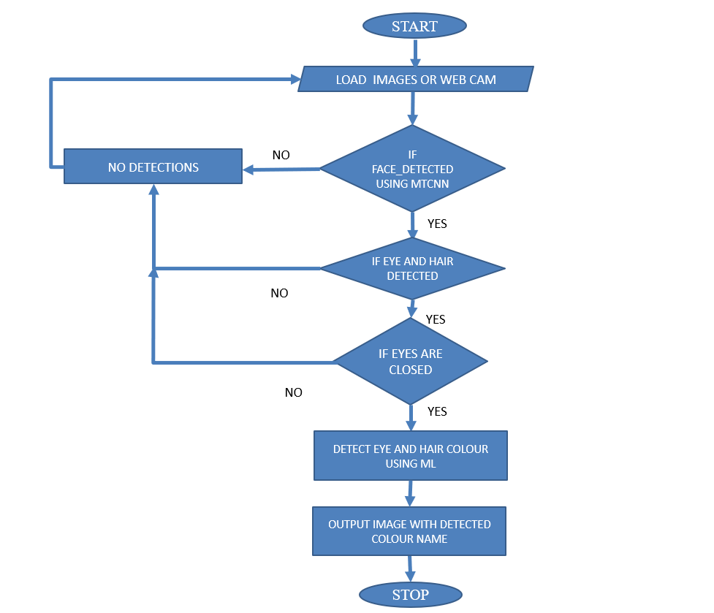

Slide 13
KLE Society’s
KLE Institute of Technology, Hubballi – 30
Department of Computer Science and Engineering
METHODOLOGY
As proposed the project work would start its journey from collecting the various relevant literatures available about the existing context aware computing architectures around the world.
This will help to arrive at a better solution for the proposed architectural design.
This involves studying the various existing architectures and comparing those with that of the requirement of our system.
In case, an existing architectural framework does not prove appropriate / adequate for the System, the investigations shall continue for the evolution of a new architecture for the System.
Once an acceptable solution is available the design will be validated and a report on the aspects of the design that needs further improvement / replacement will be generated.
Department of CSE, KLEIT

Slide 14
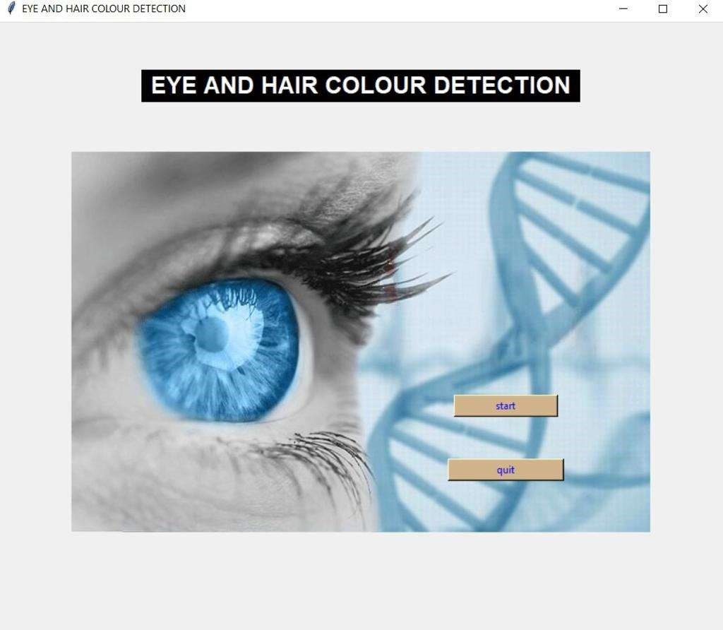
SNAP SHOTS
Fig:-User interface of our project

Slide 15
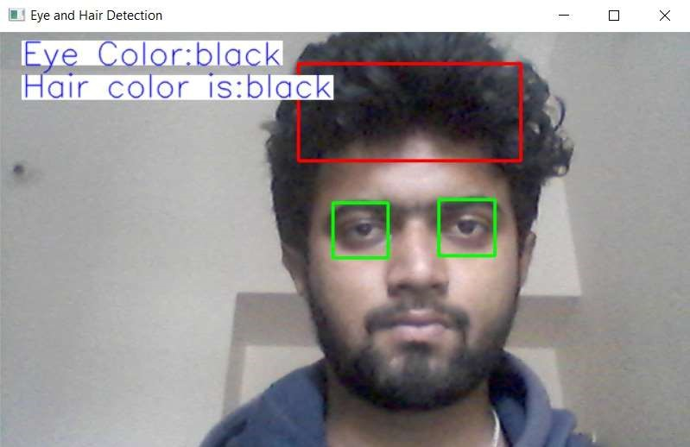
Fig :Working of the Proposed system by detecting Eye and Hair Colour

Slide 16
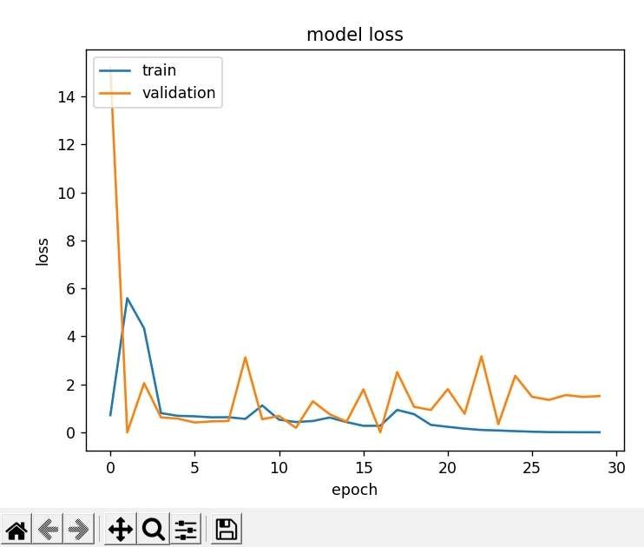
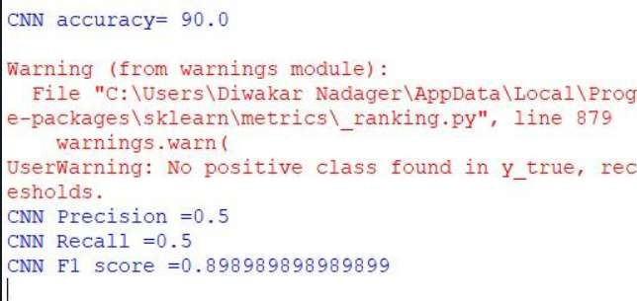
Fig. : Dailog indicating the Accuracy of the Prediction of Input
Fig. : Model loss graph

Slide 17
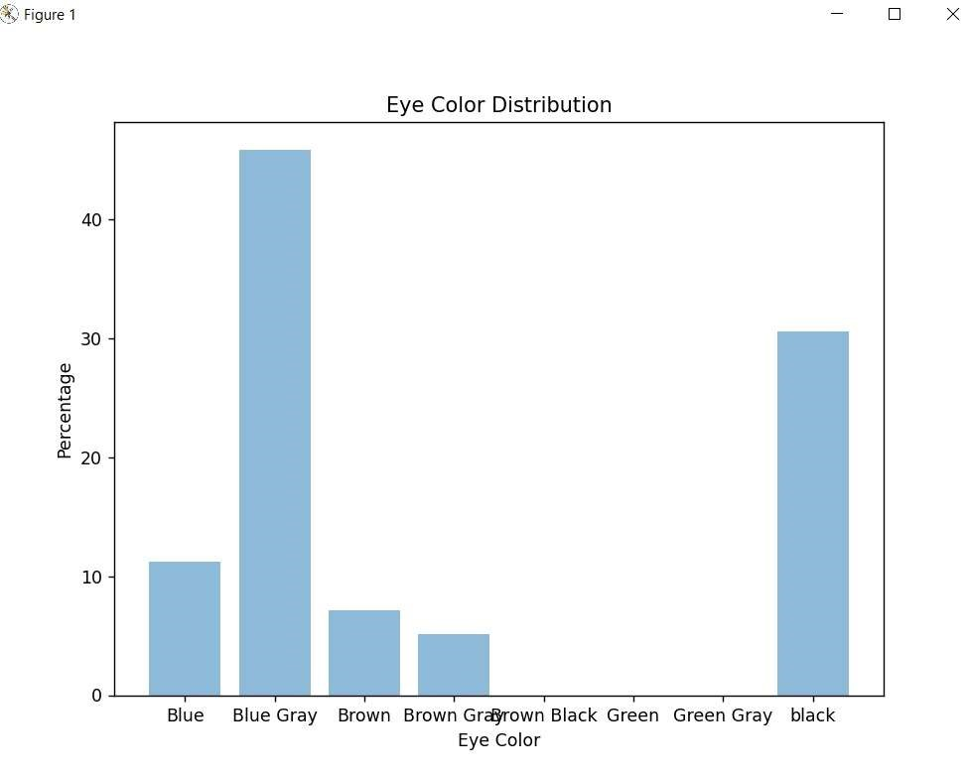
Fig . : Eye Colour Distribution graph

Slide 18
KLE Society’s
KLE Institute of Technology, Hubballi – 30
Department of Computer Science and Engineering
Conclusion
the utilization of AIML for eye and hair color detection offers promising possibilities. AIML models can accurately identify and classify eye and hair colors, enabling applications in diverse fields such as demographics, marketing, and real-time surveillance.
The objective is to develop efficient and adaptable AIML models that can swiftly detect colors, adjust to different environments, and seamlessly integrate into existing systems The accuracy rate of attacks detected by the various machine learning algorithms that have been used is also displayed by this system
Real-time eye and hair color detection holds particular significance in surveillance systems and live video analysis. The focus should be on optimizing speed and efficiency, ensuring adaptability to different environments, and seamless integration into existing systems. With these advancements, AIML can enhance eye and hair color detection, unlocking valuable insights and empowering a range of industries.
Department of CSE, KLEIT

Slide 19
BIBILOGRAPHY
Parra EJ. Human pigmentation variation “evolution, genetic basis, and implications for public health.”
Kayser M, de Knijff P. Improving human forensics through advances in genetics, genomics and molecular biology.”
Sturm RA, Frudakis TN. “Eye colour: portals into pigmentation genes andancestry Trends Genet. (2019).”
Imesch PD, Wallow IH, Albert DM. “The colour of the human eye: a review ofmorphologic correlates and of some conditions that affect iridial pigmentation.”
Kayser M, Schneider PM. “DNA-based prediction of human externally visible characteristics in forensics.”

Slide 20
Butler K, Peck M, Hart J, Schanfield M, Podini D. Molecular “eyewitness Forensic prediction of phenotype and ancestry.”
Kayser M. Forensic DNA Phenotyping “predicting human appearance from crime scene material for investigative purposes”
Walsh S, Liu F, Ballantyne KN, van Oven M, Lao O, Kayser M. IrisPlex “a sensitive DNA tool for accurate prediction of blue and brown eye colour in the absence of ancestry information”.
Walsh S, Chaitanya L, Clarisse L, Wirken L, Draus-Barini J, Kovatsi L, MaedaH, Ishikawa T, Sijen T, de Knijff P, “DNA-based eye and hair colour prediction for forensic and anthropological usage”.
Liu F, van Duijn K, Vingerling JR, Hofman A, Uitterlinden AG, Janssens ACJW, Kayser M. “Eye colour and the prediction of complex phenotypes from genotypes”.

